Slide 1
Cloud Computing

Slide 2
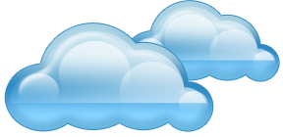
What is cloud computing?
What’s a “cloud”?
Typically a metaphor for the Internet in a network diagram
Cloud Computing
Paradigm Shift: let somebody else worry about the infrastructure…
Software + Data gets stored online and accessed via browsers

Slide 3
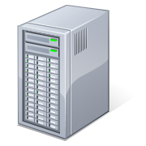
What is Cloud Computing?
Applications
Services
Computer Network
Storage (Database)
Servers
Shared pool of configurable computing resources
On-demand network access
Provisioned by the Service Provider
Adopted from: Effectively and Securely Using the Cloud Computing Paradigm by peter Mell, Tim Grance
Notes:
Cloud computing is a model for enabling convenient, on-demand network access to a shared pool of configurable computing resources (e.g., networks, servers, storage, applications, and services) that can be rapidly provisioned and released with minimal management effort or service provider interaction.
cloud computing customers do not own the physical infrastructure.
Cloud computing users avoid capital expenditure (CapEx) on hardware, software, and services when they pay a provider only for what they use.
Low shared infrastructure and costs, low management overhead, and immediate access to a broad range of applications

Slide 4
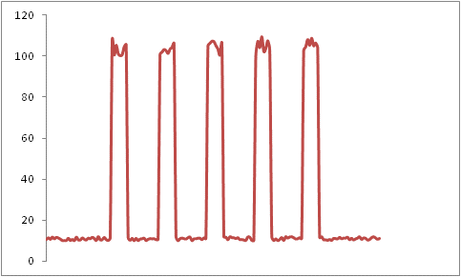
Suppose you are Forbes.com
You offer on-line real time stock market data
Why pay for capacity weekends, overnight?
9 AM - 5 PM,
M-F
Rate of Server Accesses
ALL OTHER
TIMES

Slide 5
Forbes' Solution
Host the web site in Amazon's EC2 Elastic Compute Cloud
Provision new servers every day, and deprovision them every night
Pay just $0.10* per server per hour
* more for higher capacity servers
Let Amazon worry about the hardware!

Slide 6
The end game…
Avoid capital expenditure
Rent usage from a third-party provider
Utility model for computing

Slide 7
Cloud Cost Models
Variable costs in operational expenses.
costs
costs
Variable costs in operational expenses.
Fixed Capital Costs
# of users
# of users
Traditional IT
Cloud Computing

Slide 8
Cloud Computing Categories
Infrastructure as service
Delivery of computer infrastructure as a service
Platform as a service
Deliver of computer infrastructure and a software stack as a service.
Software as a service
Deliver an application solution as a service.

Slide 9
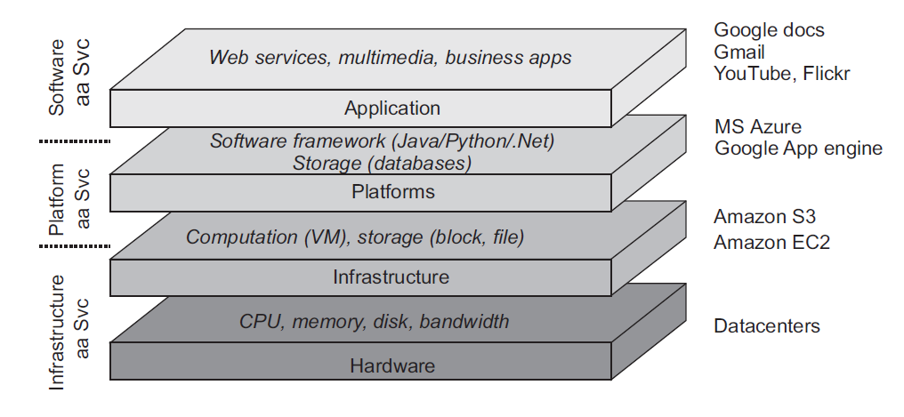
Different Layers

Slide 10
Make a distinction between four layers
Hardware: Processors, routers, power and cooling systems. Customers normally never get to see these.
Infrastructure: Deploys virtualization techniques. Evolves around allocating and managing virtual storage devices and virtual servers.
Platform: Provides higher-level abstractions for storage and such.
Application: Actual applications, such as office suites (text processors, spreadsheet applications, presentation applications). Comparable to the suite of apps shipped with OSes.

Slide 11
Benefits
Cost & management
Economies of scale, “out-sourced” resource management
Reduced Time to deployment
Ease of assembly, works “out of the box”
Scaling
On demand provisioning, co-locate data and compute
Reliability
Massive, redundant, shared resources
Sustainability
Hardware not owned

Slide 12
Cloud Computing
IT resources provided as a service
Compute, storage, databases, queues
Clouds leverage economies of scale of commodity hardware
Cheap storage, high bandwidth networks & multicore processors
Geographically distributed data centers
Offerings from Microsoft, Amazon, Google, …

Slide 13
How is it different from other paradigms?
Distributed Computing
Loosely coupled
Heterogeneous
Single administration
Cluster Computing
Tightly coupled
Homogeneous
Single System Image
Grid Computing
Large scale
Cross-organizational
Geographical distribution
Distributed management
Cloud Computing
Provisioned on demand
Service guarantee
VMs and Web 2.0-based
Derived from Hiro Kishimoto & extended to Cloud

Slide 14
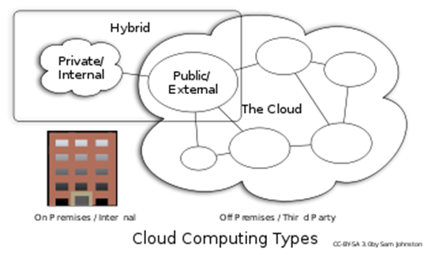
Types of Cloud Computing
Public Cloud: Computing infrastructure is hosted at the vendor’s premises.
Private Cloud: Computing architecture is dedicated to the customer and is not shared with other organizations.
Hybrid Cloud: Organizations host some critical, secure applications in private clouds. The not so critical applications are hosted in the public cloud
Cloud bursting: the organization uses its own infrastructure for normal usage, but cloud is used for peak loads.
Notes:
Public : resources are dynamically provisioned on a fine-grained, self-service basis over the Internet, via web applications/web services, from an off-site third-party provider who shares resources and bills on a fine-grained utility computing basis
Hybrid: consisting of multiple internal and/or external providers "will be typical for most enterprises". A hybrid cloud can describe configuration combining a local device, such as a Plug computer with cloud services.
Private: offerings that emulate cloud computing on private networks.

Slide 15
Discussion
We have covered the advantages of Cloud Computing.
Now, how about disadvantages/risks/concerns of Cloud computing?
Please go to
PollEv.com/cisgvsu429

Slide 16
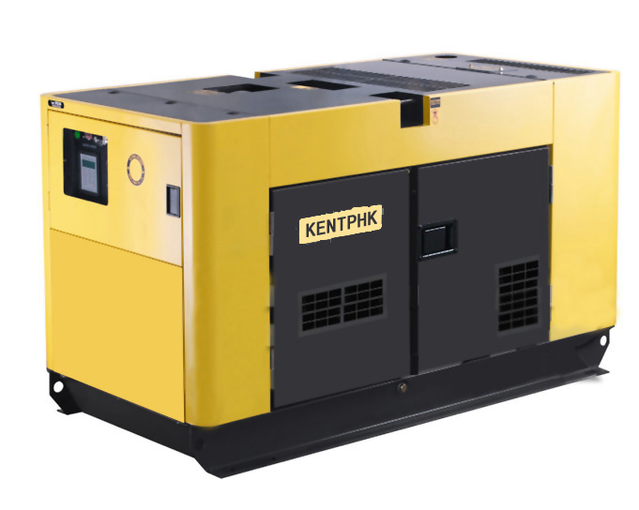
Cloud Computing Risks (enterprise)
Security
Compliance
Availability
Data Integrity

Slide 17
Cloud Computing Risks (Consumer)
Less Privacy Protection Under the Law
Data Lock-In
Third Party Control
Availability (requires always on Internet access)
Notes:
Vendor lock-in is a situation in which a customer using a product or service cannot easily transition to a competitor's product or service. Vendor lock-in is usually the result of proprietary technologies that are incompatible with those of competitors.

Slide 18
Key enabling technology
Virtualization:
The ability to run multiple operating systems on a single physical system and share the underlying hardware resources

Slide 19
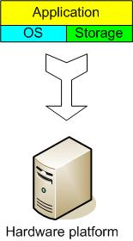
The Traditional Server Concept
Web Server
Windows
IIS
App Server
Linux
Glassfish
DB Server
Linux
MySQL
Email
Windows
Exchange

Slide 20
The Traditional Server Concept
Pros
Easy to conceptualize
Fairly easy to deploy
Easy to backup
Virtually any application/service can be run from this type of setup
Cons
Expensive to acquire and maintain hardware
Not very scalable
Difficult to replicate
Redundancy is difficult to implement
Vulnerable to hardware outages
In many cases, processor is under-utilized

Slide 21
Virtualization
Virtual workspaces:
An abstraction of an execution environment that can be made dynamically available to authorized clients by using well-defined protocols
Resource quota (e.g. CPU, memory share),
Software configuration (e.g. O/S, provided services).
Implement on Virtual Machines (VMs):
Abstraction of a physical host machine,
Hypervisor intercepts and emulates instructions from VMs, and allows management of VMs,
VMWare, Xen, etc.
Provide infrastructure API:
Plug-ins to hardware/support structures
App
App
App
App
App
App
Guest OS
(Linux)
Guest OS
(NetBSD)
Guest OS
(Windows)
VM
VM
VM
Virtual Machine Monitor (VMM) / Hypervisor
Hardware

Slide 22
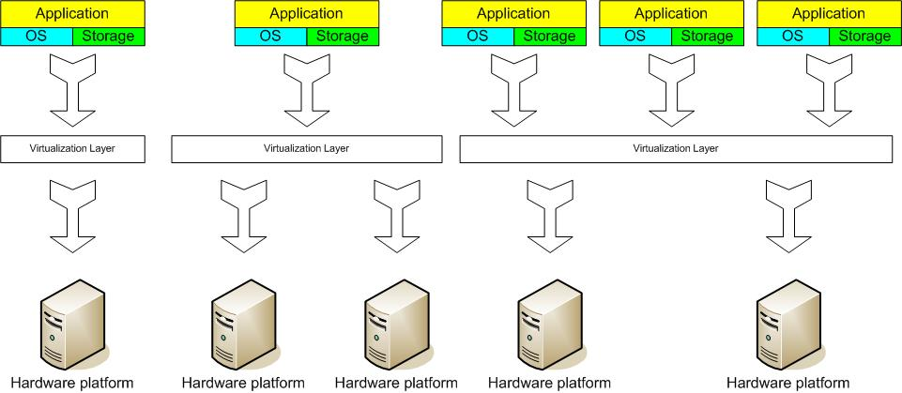
The Virtual Server Concept
Virtual Machine Monitor (VMM) layer between Guest OS and hardware

Slide 23
Structure*
* adapted from a diagram in VMware white paper, Virtualization Overview
Server
1
Guest OS
Server
2
Guest OS
Clustering
Service Console
VMM (Virtual Machine Monitor)
x86 Architecture
Intercepts hardware requests

Slide 24
The Virtual Server Concept
Virtual servers seek to encapsulate the server software away from the hardware
This includes the OS, the applications, and the storage for that server.
Servers end up as mere files stored on a physical box, or in enterprise storage.
A virtual server can be serviced by one or more hosts, and one host may house more than one virtual server.

Slide 25
The Virtual Server Concept
Virtual servers can still be referred to by their function i.e., email server, database server, etc.
If the environment is built correctly, virtual servers will not be affected by the loss of a host.
Hosts may be removed and introduced almost at will to accommodate maintenance.

Slide 26
The Virtual Server Concept
Virtual servers can be scaled out easily.
If the administrators find that the resources supporting a virtual server are being taxed too much, they can adjust the amount of resources allocated to that virtual server
Server templates can be created in a virtual environment to be used to create multiple, identical virtual servers
Virtual servers themselves can be migrated from host to host almost at will.

Slide 27
The Virtual Server Concept
Pros
Resource pooling
Highly redundant
Highly available
Rapidly deploy new servers
Easy to deploy
Reconfigurable while services are running
Optimizes physical resources by doing more with less
Cons
Slightly harder to conceptualize
Slightly more costly (must buy hardware, OS, Apps, and now the abstraction layer)
App
App
App
OS
OS
OS
Hypervisor
Hardware
Virtualized Stack

Slide 28
What is Docker?
Docker is an open-source project that automates the deployment of applications inside software containers, by providing an additional layer of abstraction and automation of operating system–level virtualization on Linux.
[Source: en.wikipedia.org]

Slide 29
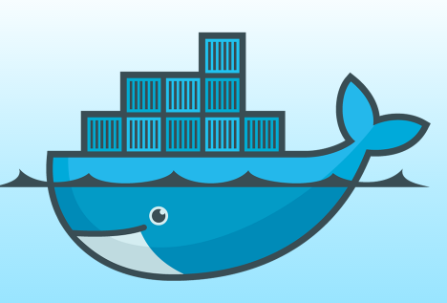
Docker
[www.docker.com]
Provide a uniformed wrapper around a software package: «Build, Ship and Run Any App, Anywhere» [www.docker.com]
Similar to shipping containers: The container is always the same, regardless of the contents and thus fits on all trucks, cranes, ships, ...

Slide 30
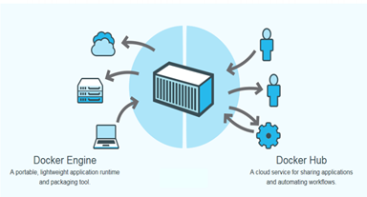
Docker
Open platform for developers and system administrators to build and test cloud applications

Slide 31
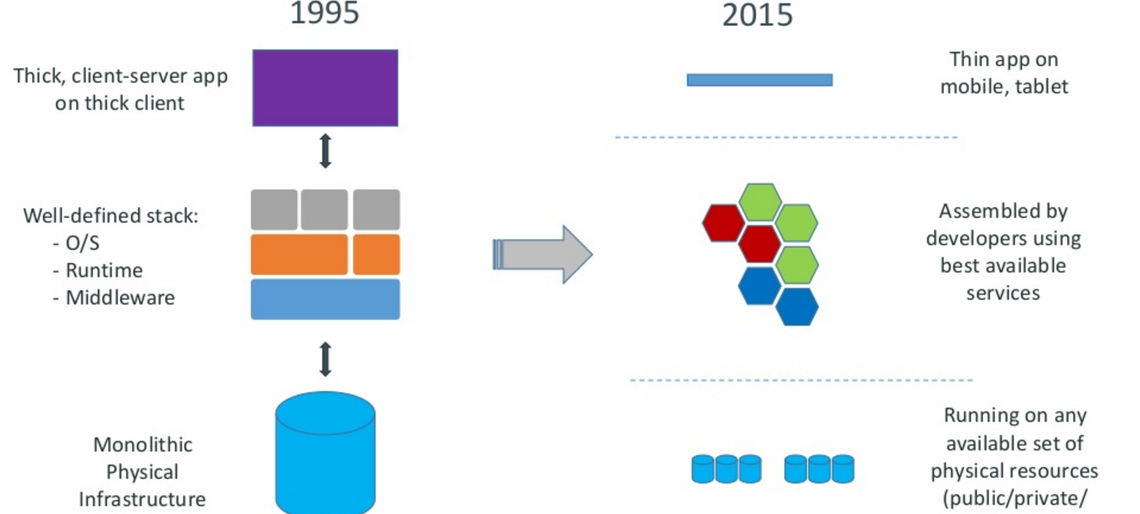
Motivation

Slide 32
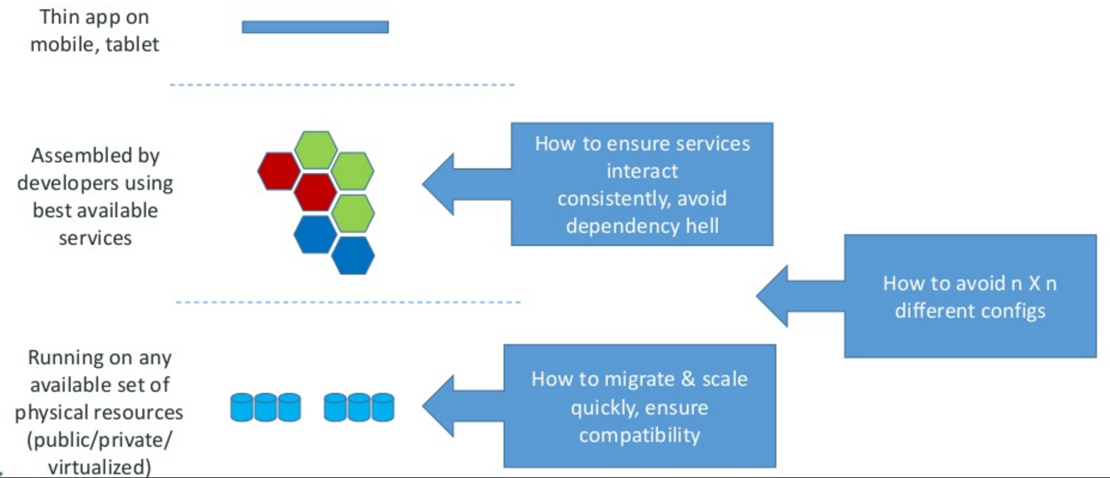
Motivation –the challenge

Slide 33
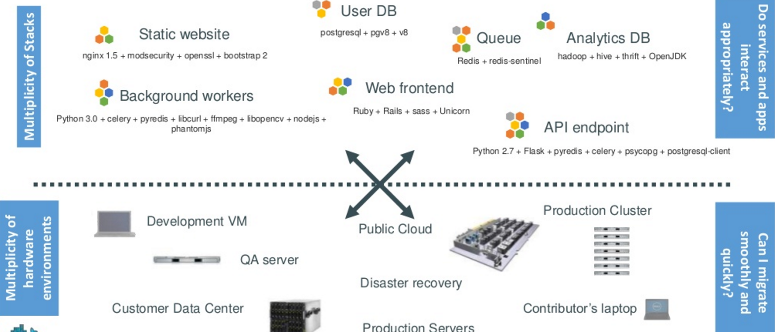
The challenge continued
Notes:
Static web: nginx is a fast webserver, generally faster than Apache
Queue: Redis = in-memory data structure store, used as a database, cache and message broker.
Analytics DB: Hadoop = Hive = Hadoop based Database

Slide 34
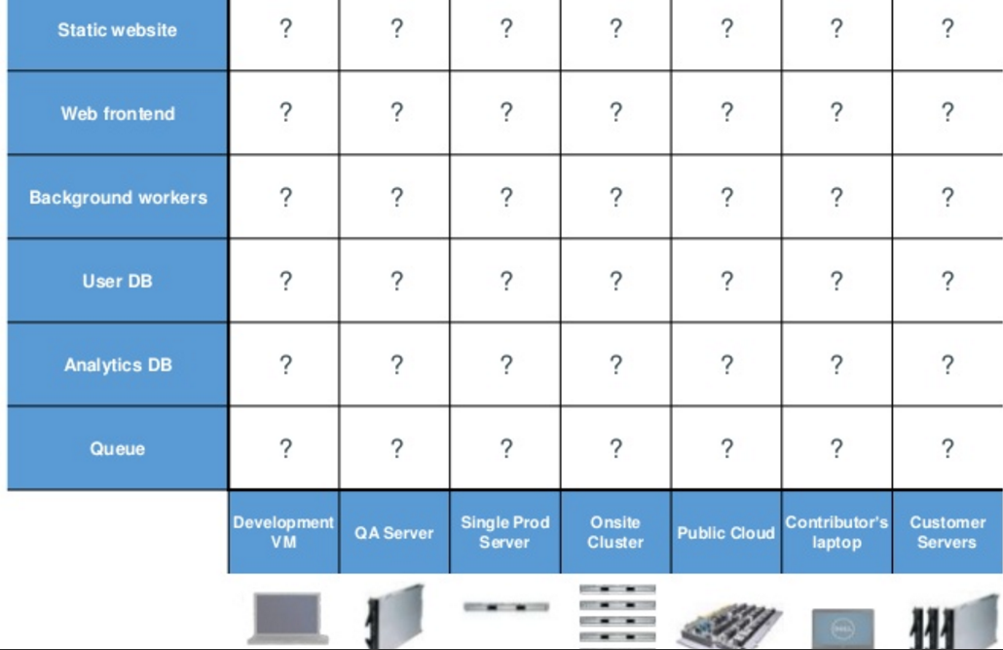
Looking for all kinds of solutions…
Too many to consider

Slide 35
THE ANSWER
Something called a CONTAINER ----which is the business Docker has created.
Here is an analogy that Docker use’s to let you understand….

Slide 36
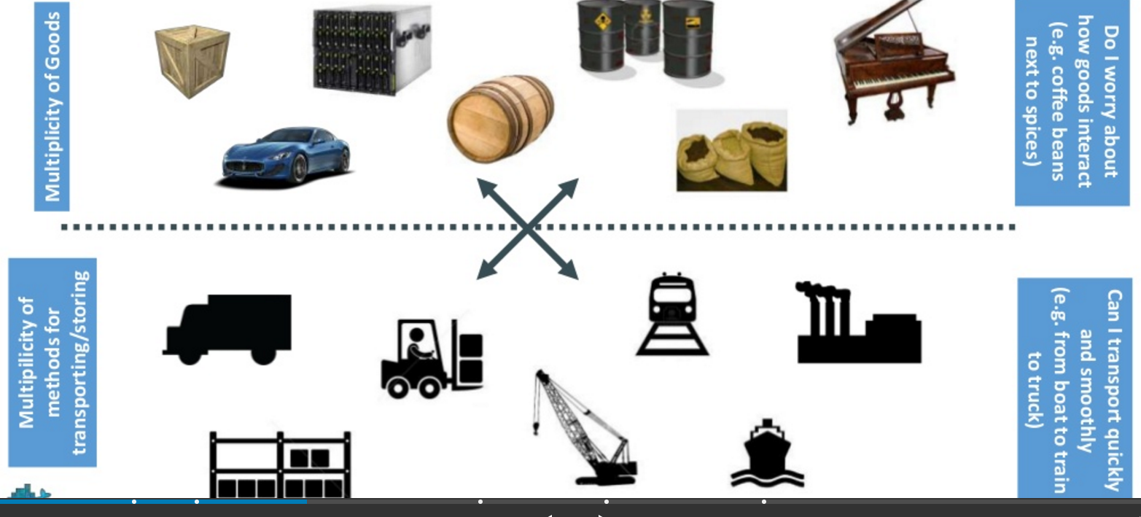
Understanding….an analogy …cargo transport pre-1960

Slide 37
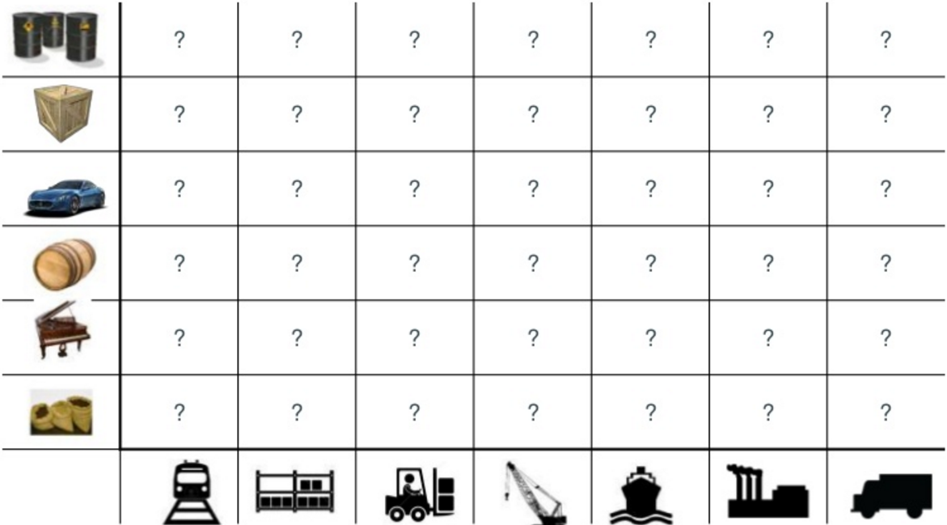
What are the possibilities

Slide 38
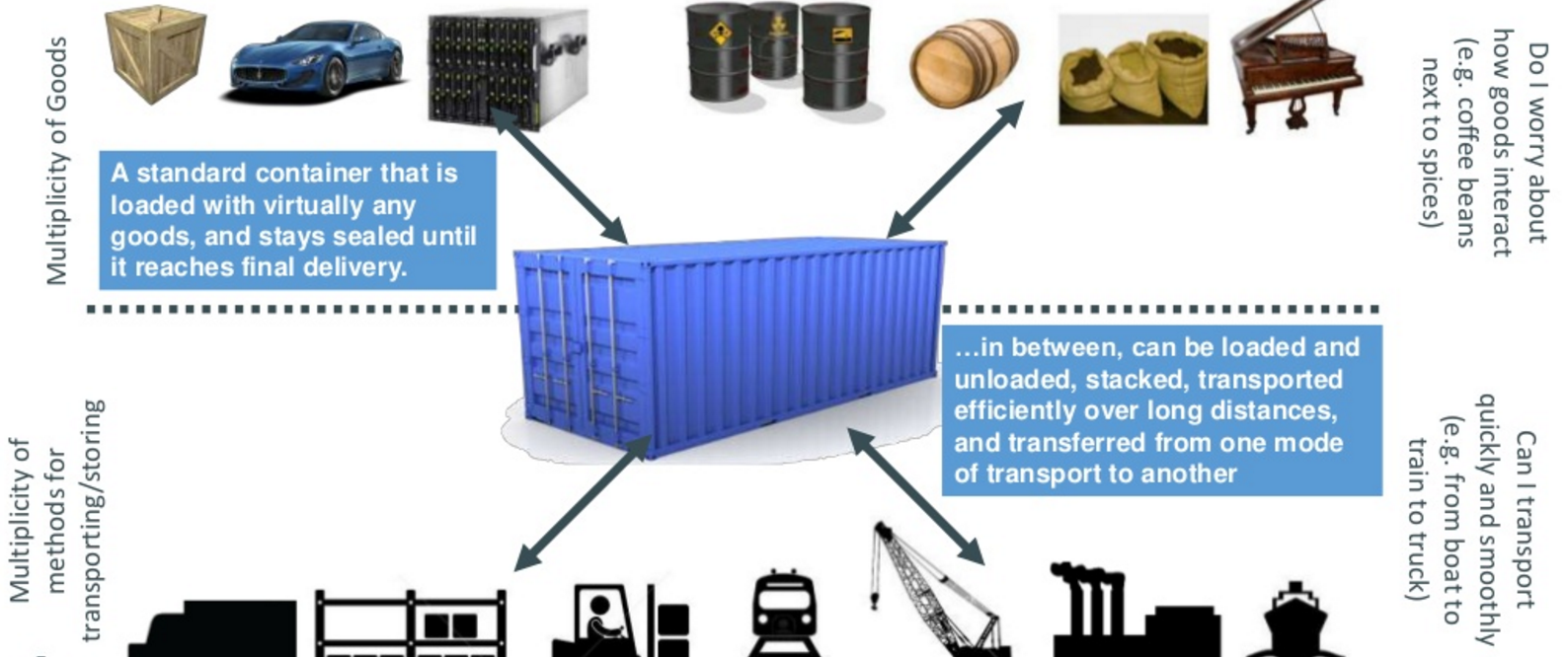
SOLUTION—shipping containers

Slide 39
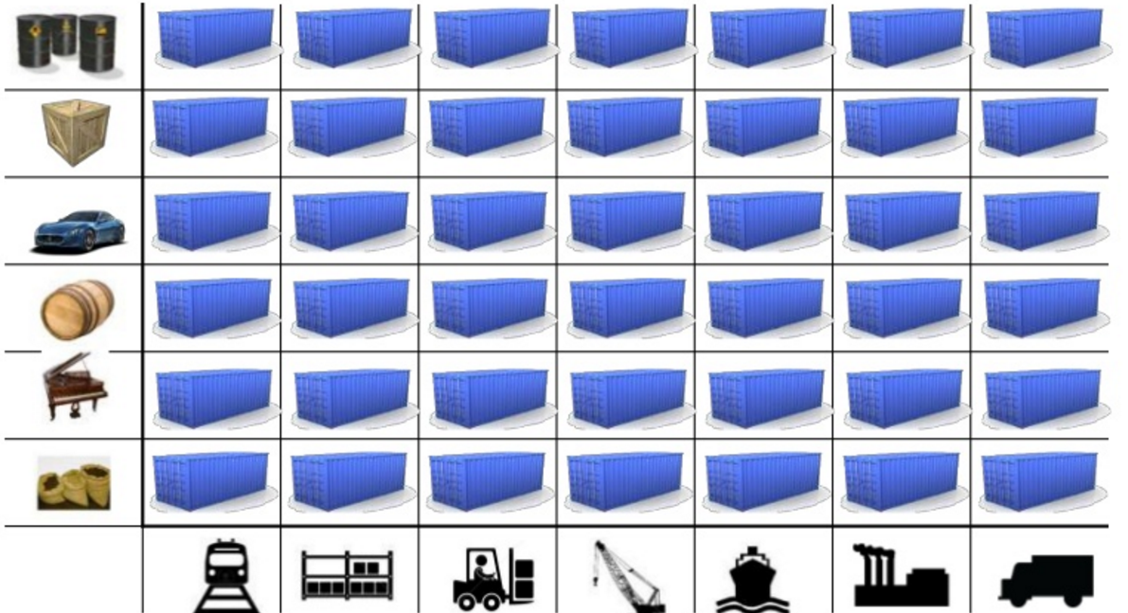
This solved the problem

Slide 40
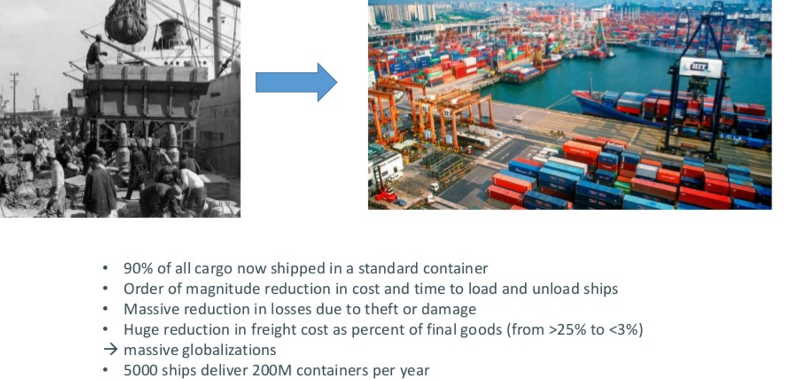
Today shipping is done with containers

Slide 41
How does this container idea translate to our problem

Slide 42
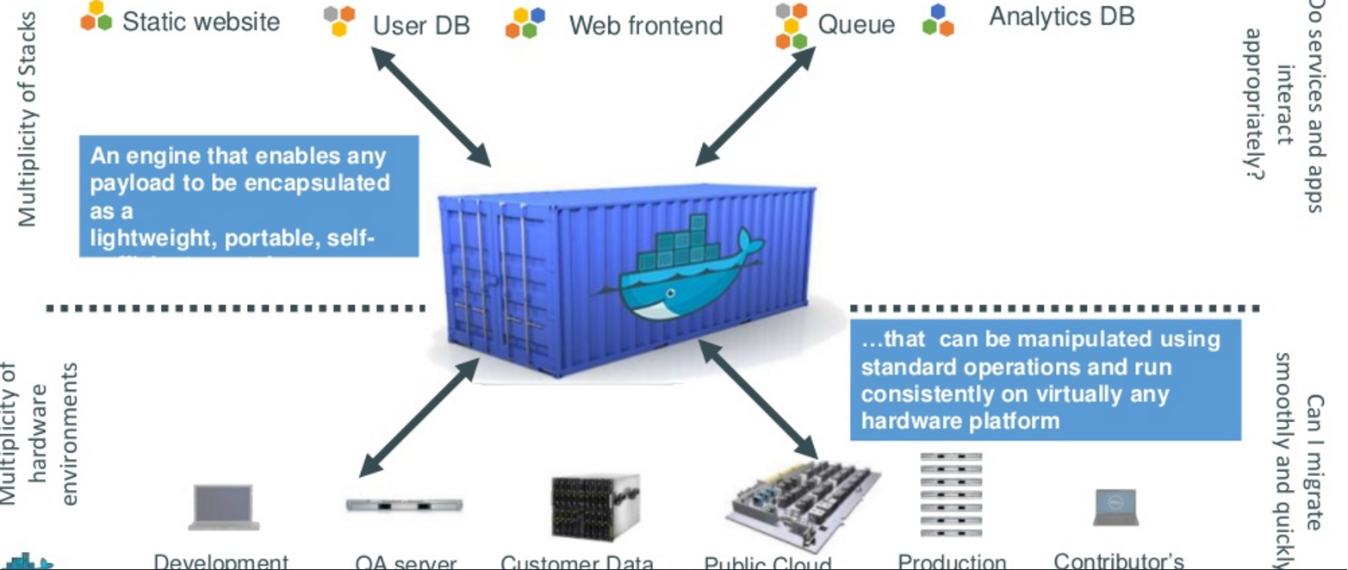
How does this container idea translate to our problem—container for code????

Slide 43
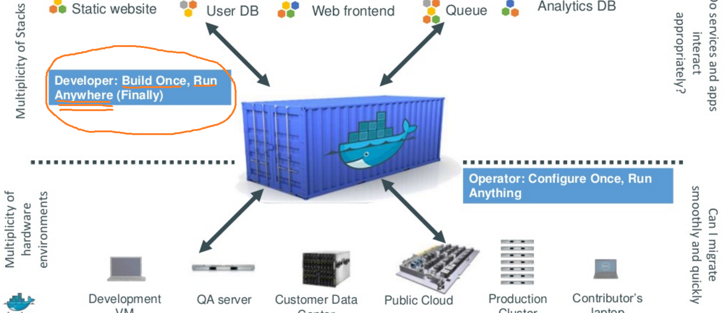
Do once run anywhere

Slide 44
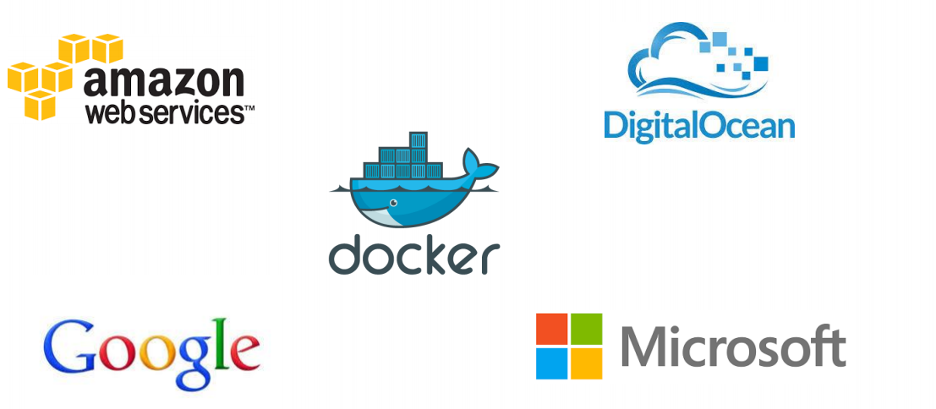
Docker supported in many Cloud platforms

Slide 45
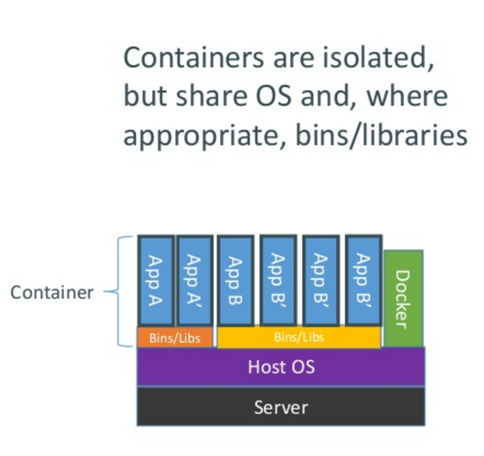
How does Docker containers work?

Slide 46
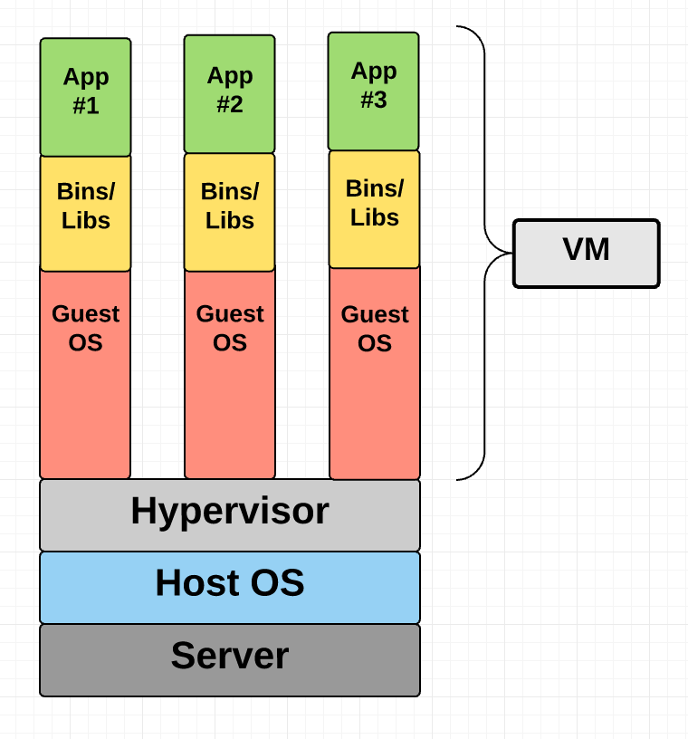
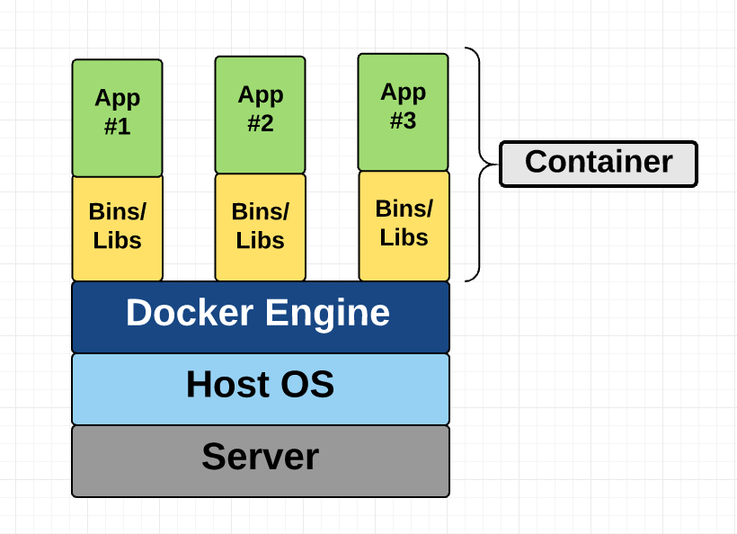
VM vs. Docker

Slide 47
Cloud Storage
Several large Web companies are now exploiting the fact that they have data storage capacity that can be hired out to others.
allows data stored remotely to be temporarily cached on desktop computers, mobile phones or other Internet-linked devices.
Amazon’s Simple Storage Solution (S3)
Unlimited Storage.
Pay for what you use:
$0.20 per GByte of data transferred,
$0.15 per GByte-Month for storage used,
1TBytes, 40,000 downloads in 24 hours - $200

Slide 48
Utility Computing – EC2
Amazon Elastic Compute Cloud (EC2):
Elastic, marshal 1 to 100+ PCs via WS,
Machine Specs…,
Fairly cheap!
Powered by Xen – a Virtual Machine:
Different from Vmware and VPC as uses “para-virtualization” where the guest OS is modified to use special hyper-calls:
Hardware contributions by Intel (VT-x/Vanderpool) and AMD (AMD-V).
Supports “Live Migration” of a virtual machine between hosts.
Linux, Windows, OpenSolaris
Management Console

Slide 49
Opportunities
The use of the cloud provides a number of opportunities:
It enables services to be used without any understanding of their infrastructure.
Cloud computing works using economies of scale:
It potentially lowers the outlay expense for start up companies, as they would no longer need to buy their own software or servers.
Cost would be by on-demand pricing.
Vendors and Service providers claim costs by establishing an ongoing revenue stream.
Data and services are stored remotely but accessible from “anywhere”.

Slide 50
Challenges
In parallel there has been backlash against cloud computing:
Use of cloud computing means dependence on others and that could possibly limit flexibility and innovation:
The others are likely become the bigger Internet companies like Google and IBM, who may monopolise the market.
Some argue that this use of supercomputers is a return to the time of mainframe computing that the PC was a reaction against.
Security could prove to be a big issue:
It is still unclear how safe out-sourced data is and when using these services ownership of data is not always clear.
There are also issues relating to policy and access:
If your data is stored abroad whose policy do you adhere to?
What happens if the remote server goes down?
How will you then access files?
There have been cases of users being locked out of accounts and losing access to data.

Slide 51
Cloud Summary
Cloud computing is an umbrella term used to refer to Internet based development and services
A number of characteristics define cloud data, applications services and infrastructure:
Remotely hosted: Services or data are hosted on remote infrastructure.
Ubiquitous: Services or data are available from anywhere.
Commodified: The result is a utility computing model similar to traditional that of traditional utilities, like gas and electricity - you pay for what you would want!

Slide 52
Storage Area Network (SAN)

Slide 53
What is SAN about
Data is Asset
How to Store Data?
How to Access Data?
How to Manage Data Storage?

Slide 54
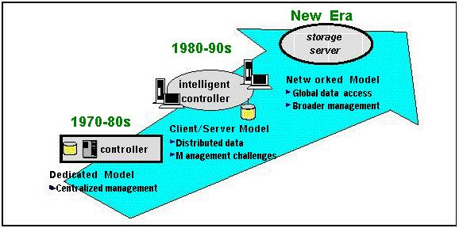
Evolution in Storage Architecture

Slide 55
Problem we are facing
Scalability --Rapidly growing data volume
Connectivity --Distributed data sharing
24/7 availability, no single point failure
High performance
Easy management

Slide 56
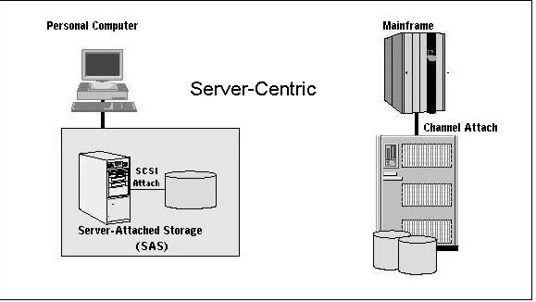
Server-Attached Storage (SAS)

Slide 57
SAS -- How to Share Data
Each server has its own data copy
Scalability: Poor
Management: how to keep data sync?
Connectivity: N/A
One copy sharing
single point failure
how to make back up without affecting service?
System dependent

Slide 58
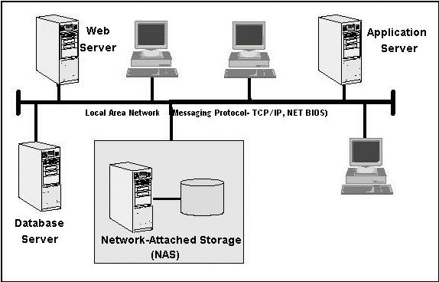
Network-Attached Storage (NAS)

Slide 59
NAS
Scalability: good
Availability: as long as the LAN and NAS device work, generally good
Performance: limited by speed of LAN, traffic conflicts, inefficient protocol
Management: OK

Slide 60
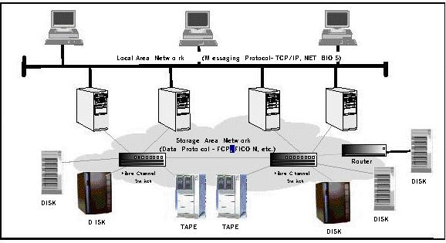
Storage Area Network (SAN)

Slide 61
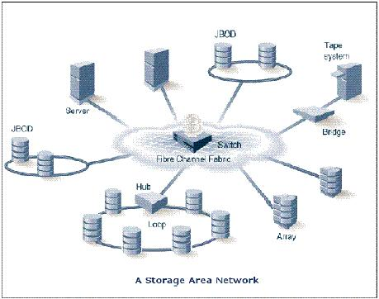
Storage Area Network (SAN)
SAN is created by using the Fiber Channel to link peripheral devices such as disk storage and tape libraries

Slide 62
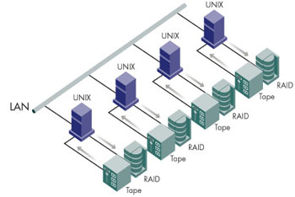
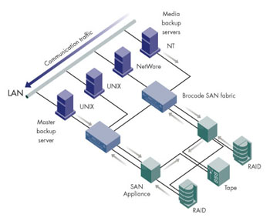
SAN Solution: Server-free back up & Restore
Without SAN
traditional network with each server attached its tape library.
With SAN:
Using single SAN tape library for backup.
Backup is centralized and effective.
Online data copies, and server downtime is minimized.
Traditional
Switches
Storage
SAN
Tape library

Slide 63
SAN: Improvement from NAS
Dedicated Fiber Channel Network for Storage
More efficient protocol
Higher availability
Reduce traffic conflict

Slide 64
Benefits of SAN
Decoupling Servers and Storage
The servers can be upgraded while leaving storage in place.
Storage can be added at will and dynamically allocated to servers without downtime.

